Slide 1
Cybersecurity awareness and countermeasures during the 2017 Norwegian parliamentary elections
European Conference of Electoral Management Bodies
Oslo – 20th April 2018
Specialist Director - Roar Thon

Slide 3
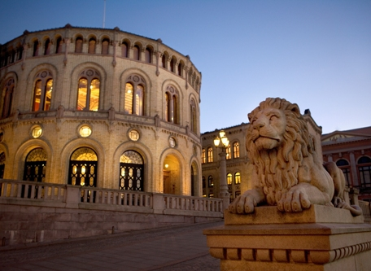
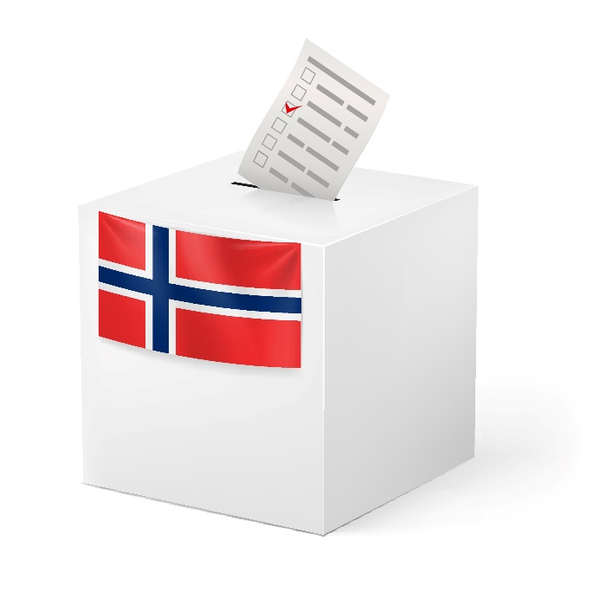
The Storting
The voting
system
The political parties
Private organizations
Not subject to the National security act
Different levels of available resources
Uncertainty of their level of cybersecurity
Government security
system in place
Supported by the NSM and PST
PENETRATION TESTING
DONE BY NSM
BEFORE THE ELECTION

Slide 4
Hacking
Political parties/Politicians
Hacking/Creation of
Social media accounts (real or fake)
Extract sensitive
information
from
Political parties/Politicians
Publish fake news
from
Hacked accounts
or
fake accounts

Slide 5
HUMANS
TECHNOLOGY
PROCESSES

Slide 6
WHAT IF…
You are not able to communicate your
political message during the election campaign?
Initial
contact with the political parties
Meeting
with management
We offered and delivered
Awareness training
Technical reviews
Technical advise
Establishing communication channels and incident procedures
Not obligated to say yes
WHAT IF…
You have to spend all your time in the media talking
about a story that has nothing to do with politics?

Slide 7
National states
Single individuals

Slide 8
SOCIAL MEDIA COUNTERMEASURES
Established a preparedness system and communication channel with Facebook, Twitter and others.
Creating a 24/7 ability to report and respond to incidents regarding official accounts belonging to the government, political parties and central politicians.

Slide 9
VERIFICATION OF ALL SOCIAL MEDIA ACCOUNTS
Account ownership
Password routines
2FA

Slide 10
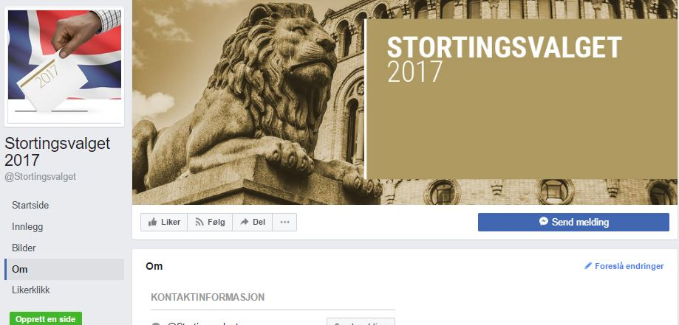

Slide 11
Information to each individual that could be elected.
Advice on
Physical security
Cybersecurity
Produced by the:
National Security Authority
The Police Security Service
The Norwegian Intelligence Service

Slide 12
SUMMARY/LESSONS LEARNED
Start early!
Identify the areas with most impact
Social media is a powerful tool – protect it!
Do not scare people – give them advice they are able to follow
Focus on simple solutions, and how to behave if
something happens

